Slide 1
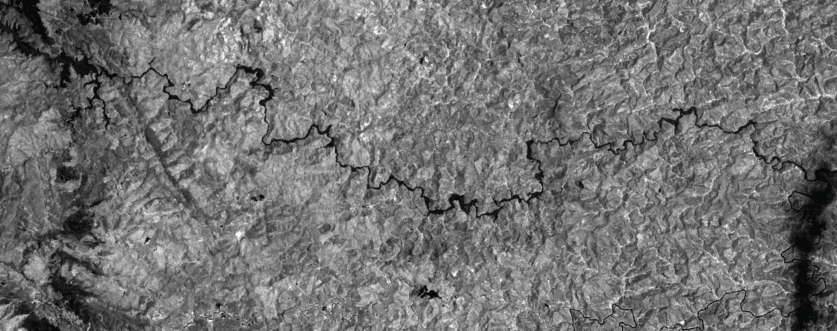
Bento Rodrigues dam collapse (2015)
Remote Sensing (SA 2021)
Lucas Schmutz

Slide 2
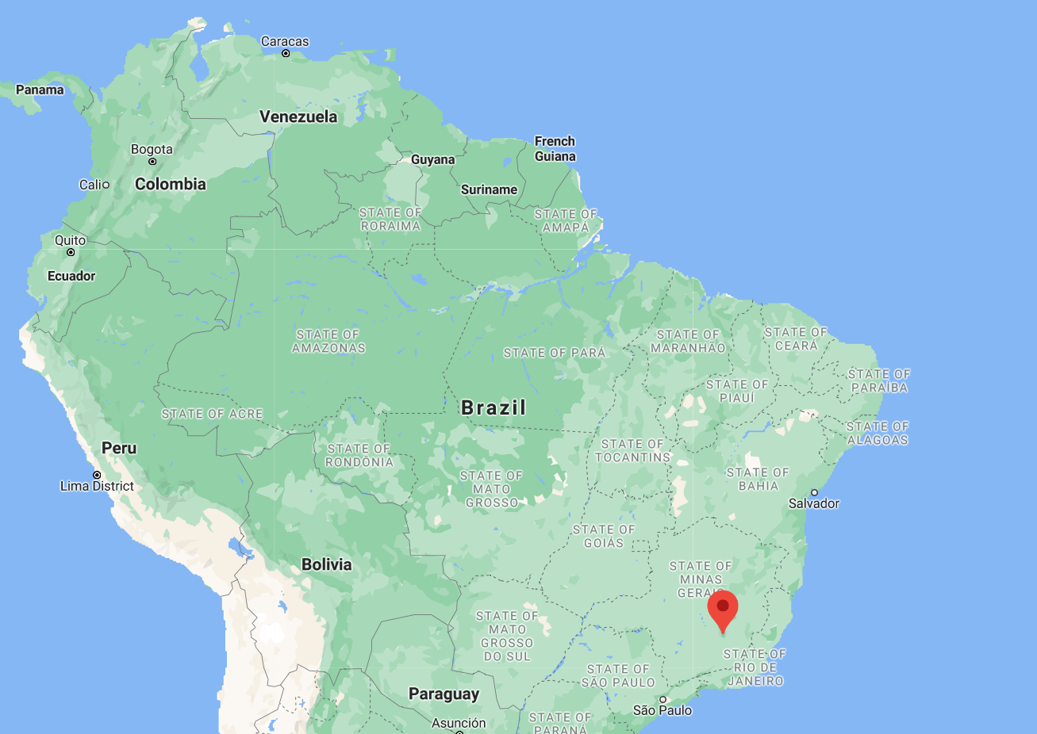
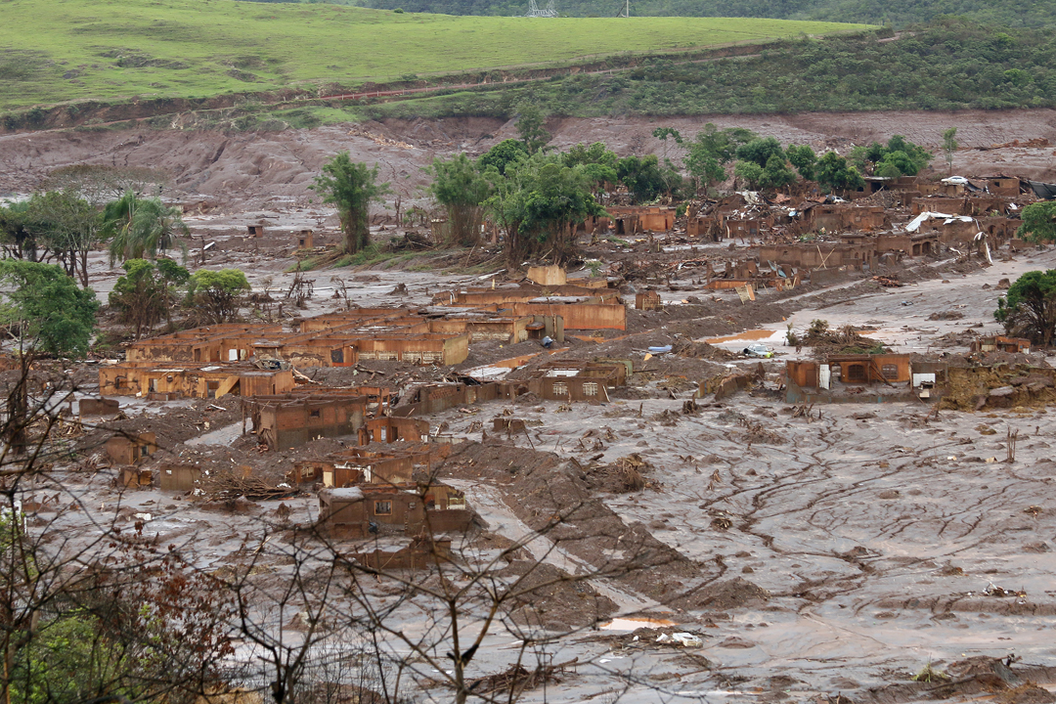
Context
5th november 2015
Collapse of the tailings dam at the Germano iron ore mine
Causing a massive toxic mudflow
200 homes destroyed and 19 deaths
Contamination upto the Atlantic ocean 620 km downstream
Source : Senado Federal, https://commons.wikimedia.org/wiki/File:Bento_Rodrigues,_Mariana,_Minas_Gerais_(22828956680).jpg

Slide 3
Data availability
Exploration through GLOVIS
Criteria for the search :
Before and after the event
Low cloud cover
This returns two suitable images from LANDSAT 8 :
Before image dating from 11 october 2015
After image dating from 12 november 2015

Slide 4
Event spectral characteristics
The mudflow is brown and is deposited by the flooding
Changes in reflectance in bands 4,3,2
The mudflow is mostly water
Strong absorbance in IR, bands 5, 6, 7

Slide 5
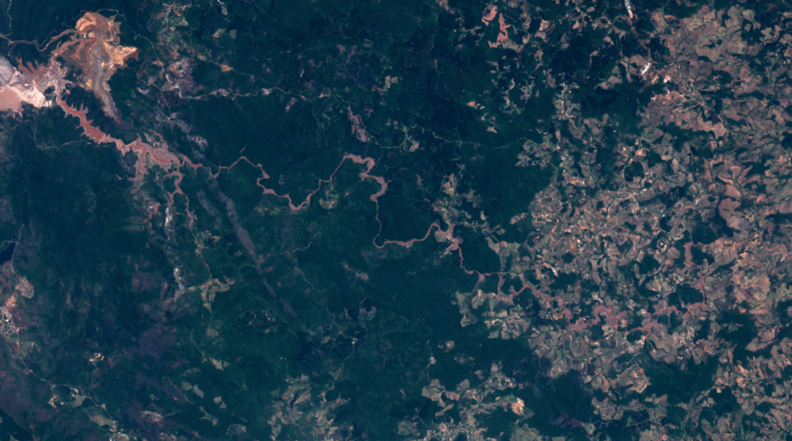
Data exploration
Bands 4, 3, 2

Slide 6
Data exploration
Band 5 : NIR

Slide 7
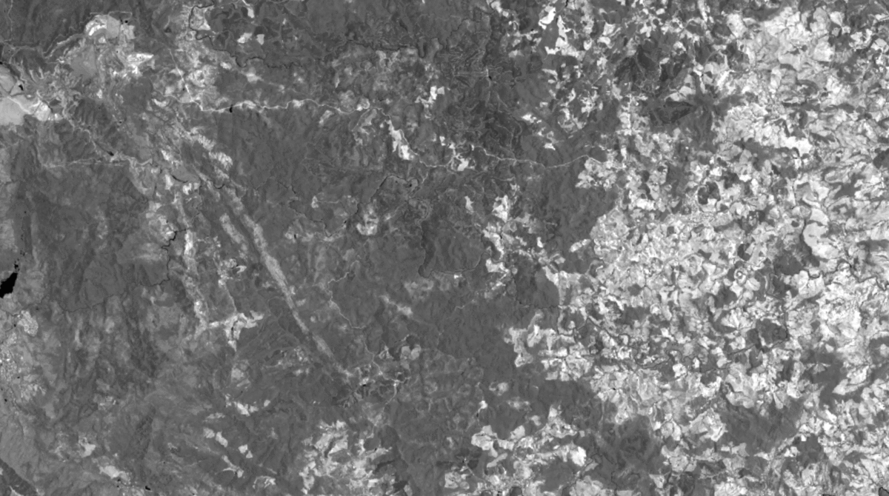
Data exploration
Band 6 : SWIR

Slide 8
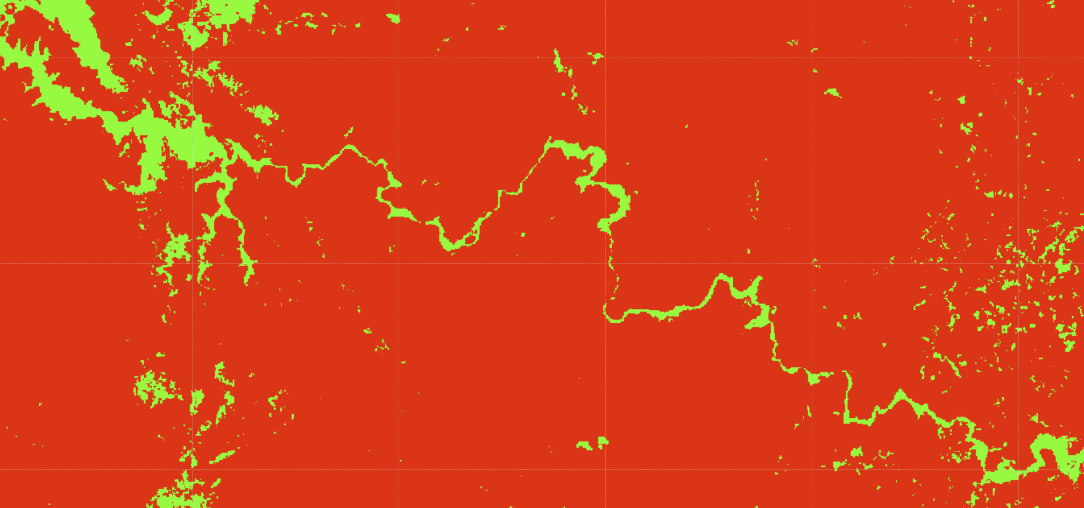
Possible methods
Classifier

Slide 9
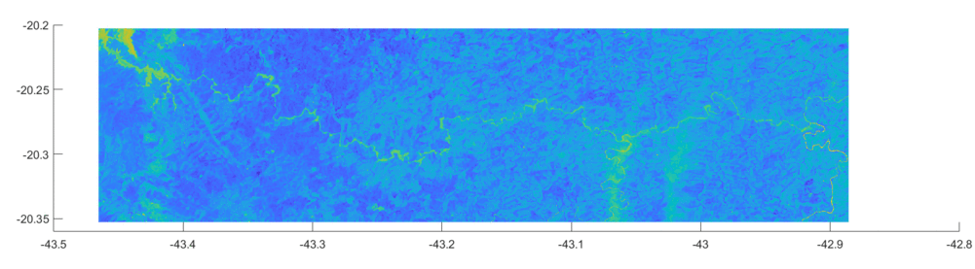
Possible methods
NDWI using bands 5 and 3

Slide 10
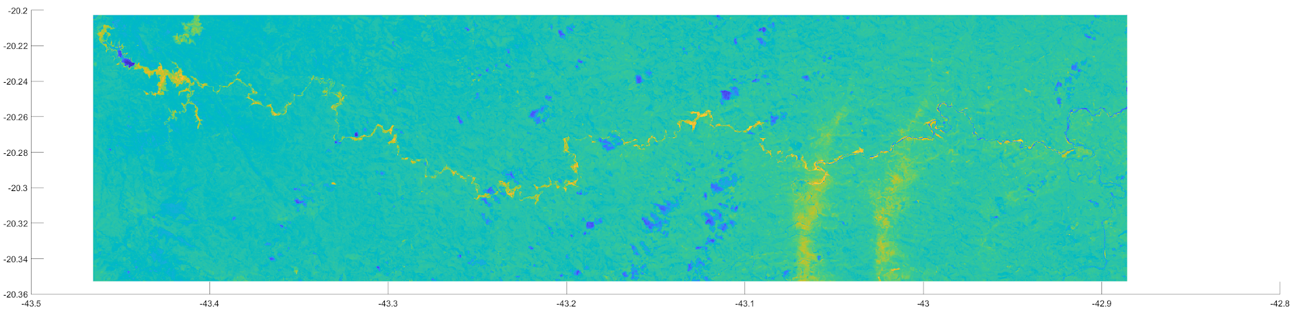
Possible methods
Difference on NDWI (B5, B3)

Slide 11
Possible methods
Merging the difference on the NDWI with a DEM
Adding per pixel constraints
Threshold on the NDWI difference +
Changes in B5 reflectance → B5_after < B5_before
Manually selecting the zone of study
...

Slide 12
Questions ?

